Slide 1


Slide 2
CHAPTER 4 SAMPLING AND ESTIMATION

Slide 3
INTRODUCTION TO SAMPLING

Slide 4
Essence of Sampling
Sampling is a process of selecting subset of observations/records from a population to make inference about various population parameters such as mean, proportion, standard deviation, etc
It is an important step in inferential statistics since an incorrect
sample may lead to wrong inference about the population
Sampling is necessary when it is difficult or expensive to collect data on the entire population. The inference about the population is made based on the sample that was collected; incorrect sample may lead to incorrect inference about the population.

Slide 5
POPULATION PARAMETERS
Measures such as mean and standard deviation calculated using the entire population are called population parameters
The population parameters mean and standard deviation are usually denoted using symbols μ and σ, respectively
SAMPLE STATISTIC
When population parameters are estimated from sample they are called sample statistic or statistic
The sample statistic is denoted using symbols (for mean) and S (or s for standard deviation)

Slide 6
SAMPLING
The process of identifying a subset from a population of elements (aka observations or cases) is called sampling process or simply sampling
Steps used in any Sampling process:
Identification of target population that is important for a given problem under study
Decide the sampling frame.
Determine the sample size
Sampling method

Slide 7
Random Sampling
Shewhart (1931) defines random sample as a ‘sample drawn under conditions such that the law of large number applies’
Random sampling is usually carried out without replacement, that is, an observation which is selected in the sample is removed from the population for further consideration
Random samples can also be created with replacement, that is, an observation which is selected for inclusion in the sample can again be considered since it is replaced (not removed) in the population.

Slide 8
Random Sampling - Example
Patients and length of stay (LoS) in days
Patient | 1 | 2 | 3 | 4 | 5 | 6 | 7 | 8 | 9 | 10
LoS | 4 | 20 | 12 | 13 | 15 | 17 | 16 | 20 | 9 | 17
RANDBETWEEN(1, 10) (an Excel Function) and the corresponding
samples (length of stay of patients selected in the sample)
Random Numbers |  |  |  |  | Corresponding Sample (LoS value)
3 | 4 | 5 | 1 | 8 | 12 | 13 | 15 | 4 | 20
1 | 7 | 9 | 1 | 3 | 4 | 16 | 9 | 4 | 12
8 | 4 | 7 | 3 | 5 | 20 | 13 | 16 | 12 | 15

Slide 9
Stratified Sampling
The population can be divided into mutually exclusive groups using some factor (for example, age, gender, marital status, income, geographical regions, etc.). The groups, thus, formed are called stratum
It is important that the groups are mutually exclusive and
exhaustive of the population.

Slide 10
Stratified Sampling -Examples
Amount of time spent by male and female users in sending
messages in a day. Here the strata are male and female users.
Efficacy of a drug among different age groups. Age group can be classified into categories such as less than 40, between 41 and 60, and over 60 years of age.
Performance of children in school and the parents’ marital status. Here, marital status can be (a) Single, (b) Married, (d) Divorced. In this case we assume that the parent’s marital status may influence children’s academic performance.
Television rating points for a program across different
geographical regions of a country. For India,
geographical
regions could be different states of the country.

Slide 11
Steps in creating stratified sample
Identify the factor that can be used for creating strata (for example: factor = Age; Strata 1: age less than 40; Strata 2: age between 41 and 60; and Strata 3: Age more than 60).
Calculate the proportion of each stratum in the population (say
p₁, p₂, and p₃ for three strata identified in step 1).
Calculate the sample size (say N). The sample size for strata 1, 2, and 3 identified in step 2 are p₁ × N, p₂ × N, and p₃ × N, respectively.
Use random sampling procedure explained in Section 4.4.1 to
generate random samples in each strata.
Combine samples from each stratum to create the final sample.

Slide 12
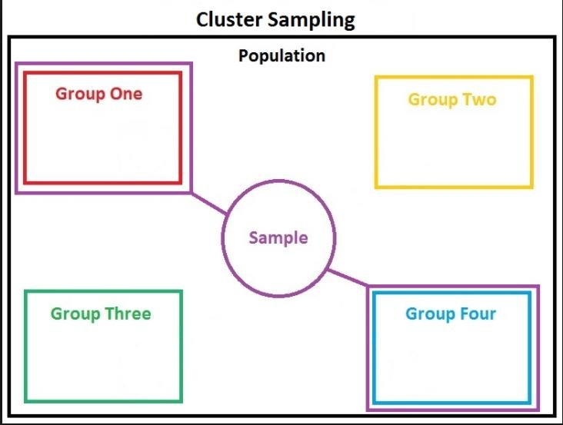
Cluster Sampling
In cluster sampling, the population mutually exclusive clusters
is divided into

Slide 13
Cluster Sampling - Steps
Identify the clusters (example: different models of smart phones sold by a manufacturer, customers from different geographical locations).
Using random sampling select the clusters.
Select all units in the clusters selected in step 2 and form the sample. If the size is too large, a random sampling within the clusters identified in step 2 may be used for final sample.
Stratified sampling and cluster sampling are similar; the major difference is that in a stratified sample, all strata will be represented in the sample, whereas in a cluster sampling, not all clusters will be represented

Slide 14
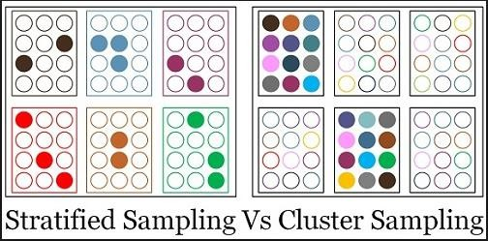
Stratified Sampling Vs Cluster Sampling
Stratified sampling and cluster sampling are similar; the major difference is that in a stratified sample, all strata will be represented in the sample, whereas in a cluster sampling, not all clusters will be represented

Slide 15
Bootstrap Aggregating (Bagging)
Bootstrap Aggregating (known as Bagging) is sampling with replacement used in machine learning algorithms, especially the random forest algorithm (Breiman, 1996)
The size of each sample and the number of samples are determined based on factors such as population size, target accuracy of the model developed using bagging and convergence, etc
Bagging is frequently used in ensemble methods (in which several models are developed and the final prediction is usually based on the majority voting)

Slide 16

Non-Probability Sampling
In a non-probability sampling, the selection of sample units
from the population does not follow any probability distribution
Sample units are selected based on convenience and/or on voluntary basis.

Slide 17
Convenience Sampling
Convenience sampling is a non-probability sampling
selected
technique in which the sample units are not
according to a probability distribution

Slide 18
Voluntary Sampling
Sampling the data is collected from people who volunteer for such data collection.
There could be bias in case of voluntary sampling

Slide 19
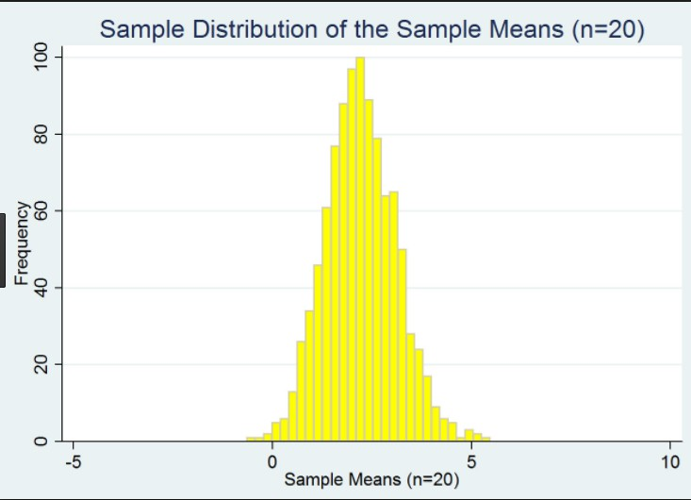
Sampling Distribution
Sampling distribution refers to the probability distribution of a statistic such as sample mean and sample standard deviation computed from several random samples of same size
Sample mean is a random variable since different samples drawn from a population are likely to give different sample mean values

Slide 20
Examples
Population of 10 observations
S.No. | 1 | 2 | 3 | 4 | 5 | 6 | 7 | 8 | 9 | 10
Value | 5 | 10 | 15 | 20 | 25 | 30 | 35 | 40 | 45 | 50
Samples of size 2 and the corresponding mean values
Sample | 5, 5 | 5, 15 | 10, 5 | 10, 15 | 10, 45 | 20, 5 | 20, 15 | 45, 15 | 50, 20 | 25, 20
Mean | 5 | 10 | 7.5 | 12.5 | 27.5 | 12.5 | 17.5 | 30 | 35 | 22.5

Slide 21
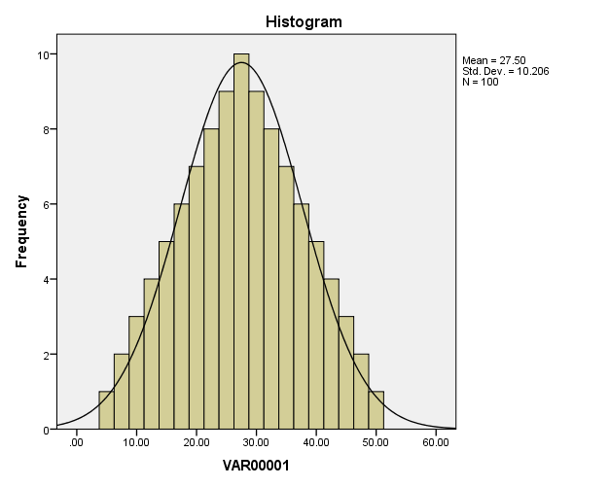
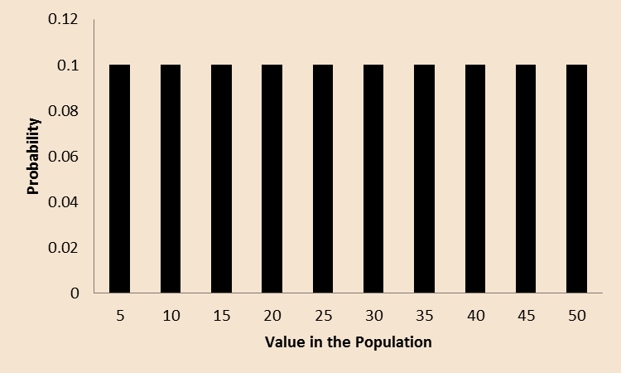
Histogram of sampling distribution of means
Probability density function of the population data

Slide 22
Central Limit Theorem (CLT)
Let S₁, S₂, …, S_{k} be samples of size n drawn from an independent and identically distributed population with mean μ and standard deviation σ.
Let X₁ , X ₂ , ..., X_{k}
be the sample means (of the samples S₁, S₂, …, S_{k}).
The sampling distribution of mean will follow a normal distribution with mean μ (same as the mean of the population)
and standard deviation σ /
n
In simple terms, central limit theorem states that for a large sample drawn from a population with mean μ and standard
deviation σ, the sampling distribution of meanX,
follows an
approximate normal distribution with mean μ and standard deviation (standard error)σ / n irrespective of the distribution of the population

Slide 23
Alternative Version of CLT
Let X₁, X₂, …, X_{n} be n random variables that are independent and identically distributed with mean μ and standard deviation σ.
Then for large n, mean
_
X =
X₁ + X ₂ + ... + X _{n}
n
follows a normal distribution with mean μ stand error σ /
n

Slide 24
Central Limit Theorem - Implications
The variable ^{X − μ} will be a standard normal distribution (mean =
σ / n
0, standard error = 1).
If S_{n} = X₁ + X₂ + … + X_{n}, then E(S_{n}) = nμ and Standard error is σ
n
The random variable ^{X − nμ} is a standard normal variate.
σ n
Regardless of the population distribution, the sampling distribution of large sample (n > 30) will follow the normal distribution with mean same as population mean and standard error
Central limit theorem is the basis for hypothesis tests such as Z test and t test. In many cases, we will have access to only a sample and the inference about the population has to be made based on sample statistic.
An important assumption of CLT is that the random variables have to be independent and identically distributed.

Slide 25
Central Limit Theorem for Proportions
If X₁, X₂, …, X_{n} are counts from a Bernoulli trials with probability of success p, E(X_{i}) = p and Var(X_{i}) = p × (1 − p), then the sampling distribution of probability of success (say pˆ ) follows an approximate normal distribution with mean p and standard error
p(1− p) / n
where n is the sample size.
∧
p− p
The variable distribution.
_{p(1− p) / n} converges to a standard normal

Slide 26
Example 4.1
It is believed that college students in Bangalore spend on average 80 minutes daily on texting using their mobile phones and the corresponding standard deviation is 25 minutes. Data from a sample of 100 students were collected for calculating the amount of time spent in texting. Calculate the probability that the average time spent by this sample of students will exceed 84 minutes.
Solution
Using the central limit theorem, the mean of the sampling distribution is 80
and the corresponding standard deviation is
25/ 100 = 2.5
The probability that the sample average is more than 84 minutes is given by
P ⎛ Z > ^{84 − 80 ⎞} = P(Z > 1.6) = 0.05479
⎜ ⎟
⎝
2.5
⎠

Slide 27
Sample Size Estimation for Mean of the population
From the central limit theorem, we know that the sampling
distribution of mean follows a normal distribution with mean μ
and standard deviation σ /
n
The standard normal variate of the sampling distribution of mean
is given by
−
₌ X − μ
Z
σ / n
The difference between the sample mean and the population mean
−
X − μ is error in estimation of the population mean. Above
equation can be written as
_{n =} ⎡ Z_{α / 2} ×σ ⎤
2
⎢⎣ ⎥⎦
D
where Z_{α/2} is the critical value for normal distribution or (1 − α) is the desired confidence in estimating the population mean and
D = X − μ is the error in estimating the population mean.

Slide 28
Example 4.3
A hospital is interested in estimating the time it takes to discharge a patient after the clearance (discharge note) by the doctor. Calculate the sample size at a confidence of 95% and maximum error in
estimation of 5 minutes. deviation is 30 minutes.
Solution
Assume that the population standard
We know that D = 5, σ = 30, α = 0.05, and |Z_{α/2}|= 1.96 for α = 0.05 we get
⎡ Z_{α / 2} ×σ ⎤ ²
⎡1.96 × 30 ⎤ ²
n = ⎢⎣
⎥⎦
= ⎢⎣
⎥⎦
≈ 138
D
5

Slide 29
Estimation of Population Parameters
Estimation is a process used for making inferences about population parameters based on samples
Point Estimate: Point estimate of a population parameter is the single value (or specific value) calculated from sample (thus called statistic).
Interval Estimate: Instead of a specific value of the parameter, in an interval estimate the parameter is said to lie in an interval (say between points a and b) with certain probability (or confidence).

Slide 30
Criteria for measuring Quality of Estimates
A. Unbiased estimate of a population parameter is an estimator whose expected value is equal to the population parameter.
Let X be an estimate of the population mean μ. If X is an unbiased estimate of μ, then
E( X ) = μ or E( X − μ) = 0

Slide 31
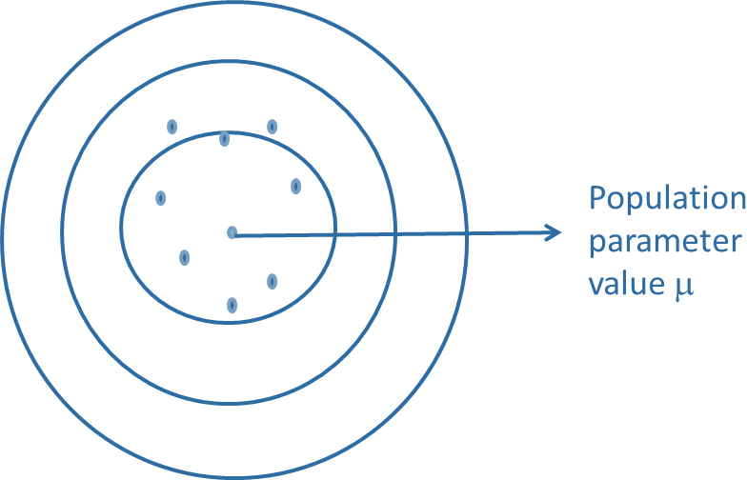
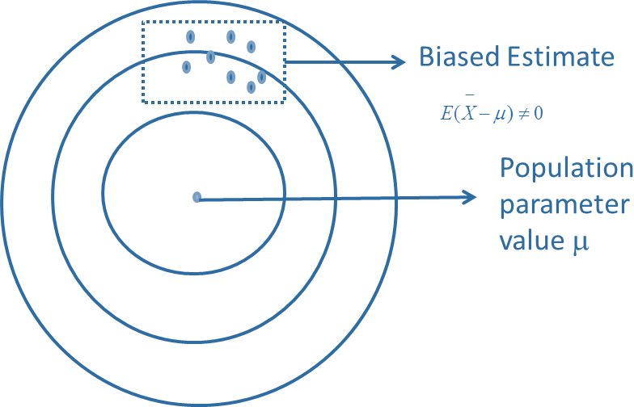
Unbiased estimate (the estimates are randomly scatted around the actual value).
Biased estimate (all estimated values are to the one side of the actual value).

Slide 32
B. Consistency: An estimator of population parameter (say X )
is said to be consistent if it converges to the true value of the
parameter (μ) as the size of the sample increases .That is, a
consistent estimator implies
lim X = μ
n→∞
C. Efficiency: An efficient estimator implies that resulting estimate of the population parameter has the minimum variance.

Slide 33
Estimation Approaches
The estimation of parameters is usually carried out using the
following approaches:
Method of Moments
Maximum Likelihood Estimate (MLE)
Bayesian Estimation

Slide 34
Method of Moments
Moments are measures used in statistics. According to method of moments, a theoretical curve Y = f(X, c₁, c₂, .., c_{n}), where c₁, c₂, … are the model parameters, can be fitted given a set of observations by equating the area and first (n − 1) moments of the observations (Schultz, 1925). The n^{th} order moment, E(X^{n}), is given by
E( X ^{n} ) = ∑ x^{n} × p(x ) when X is discrete
i i
i
Where p(x_{i}) is the probability mass function

Slide 35
For a continuous random variable, the n^{th} moment is given by
+∞
E( X ^{n} ) = ∫ x^{n}
f (x) dx
where f(x) is the probability density function.
Central moments are moments about the mean, μ, and are given
−∞
by
( )
n
∑
n
E X − μ = (x − μ) × p(x )
when X is discrete
i i
i
For a continuous random variable, the n^{th} central moment is
given by
+∞
E(X − μ)^{n} = ∫ (x − μ)^{n} f (x) dx
−∞
The moments can be connected to various measures of population. The zero-order moment is the total probability.
+∞
E( X ⁰ ) = ∫ x⁰
−∞
f (x) dx = 1

Slide 36
Similarly, the first-order moment is the mean:
+∞
E( X ¹ ) = ∫ x
−∞
f (x) dx
Second-order moment about the mean is the variance:
+∞
E( X − μ)² = ∫ (x − μ)² f (x) dx
−∞
Thus, moments can be used for estimating the population parameters

Slide 37
Estimation of Parameters using Method of Moments
Consider a uniform distribution between points a and b with probability density function [1/(b − a)]. We can use the method of moments to estimate the mean and standard deviation as shown below:
b b
_{⎡b}2 _{a}2 ⎤
1 1 1 a + b
E(X ) = ∫ x × _{b − a} dx = _{b − a ∫} x dx = _{b − a ⎢ 2} − _{2 ⎥} =
⎣
⎦
2
a a
The estimate of variance is
b
1
1 1
⎡⎛
a + b ⎞³
⎛
a + b ⎞^{3 ⎤} 1
( )
2
∫
2
E X − μ = [x − (a + b) / 2] ×
dx = × × ⎢⎜b − ⎟ − ⎜ a − ⎟ ⎥ = (b − a)²
b − a b − a 3 ⎢⎣⎝ 2 ⎠
⎝
2 ⎠ ⎥⎦ 12
a

Slide 38
Example
Estimate the expected value of Poisson and exponential random variable using method of moments.
Solution:
The probability density function of Poisson distribution is given by
_{e}−λ _{× λ}x
f (x) =
x!
The expected value is given by
E(X ) = ∑i ×
i=0
_{e}−λ _{× λ}x
= ∑i ×
i=1
_{e}−λ _{× λ}i
_{λ}i−1
∞
∞
∞
−λ
= λe
∑
i=1
x!
i!
(i −1)!

Slide 39
Now
∞
_{λ}i −1
∞
∑
i =0
_{λ}i
∑
=
= e^{λ}
_{i =1} (i −1)!
i!
Thus ,
E( X ) = λe^{−λ} e^{λ} = λ
The probability density of exponential distribution is given by
f ( x) = λe^{−λx}
∞
The expected value is given by
−λx
E( X ) = x × λe dx
∫
0
We have to solve the above integration by parts. Let u = x and
dv = λe^{−λx}dx
we get
.Then du = dx and v = − e^{−λx} Integrating by parts
∞ ∞
_{⎡e}−λx ⎤∞
1
λ
∫ x × λe^{−λx}dx = [uv]∞ − ∫ vdu = 0 − ⎢
=
0
⎥
⎥⎦
⎢⎣
λ
0
0
0

Slide 40
Estimation of Parameters Using Maximum Likelihood
Estimation
One of the frequently used methods for estimation of parameters
of probability distribution is called maximum likelihood estimation (MLE).
The main advantages of MLE are that it is mathematically rigorous and less susceptible to individual values as every data in the sample has equal weight in calculation of the estimates of the parameters
The method is very robust and thus can be used for any distribution

Slide 41
1. Start with a belief about the population (say exponential
Maximum Likelihood Estimation - STEPS
distribution).
Derive the likelihood function that estimates probability of
observing the data using the belief in step 1.
Do a natural logarithmic transformation of the likelihood function (Log likelihood function). Log likelihood function is used to simplify the computation.
Estimate the parameters that maximized the log likelihood function derived in step 3.

Slide 42
Estimation of Binomial Distribution Parameter
Consider a binomial distribution with n Bernoulli trials and each with probability of success p. The objective is to estimate the probability p. The probability density function of binomial distribution is given by
⎛ n ⎞
x n − x
f (x) = ⎜ ⎟ p (1− p)
x
⎝ ⎠
where
⎛ n ⎞ n!
⎜ ⎟ =
x x!(n − x)!
⎝ ⎠

Slide 43
Let x₁, x₂, …, x_{m} be the number of success obtained out of n successive trials repeated m times. The corresponding joint probability is the likelihood of observing x₁, x₂, …, x_{m} successes out of n trails repeated m times and is given by
m
∏
i =i
^{m} ⎛ n ⎞
L(x₁, x₂ ,.., x_{m} | p, n) =
f (x ) =
∏
⎜ ⎟p^{xi} (1− p)^{n− xi}
i
x
i =1⎝ i ⎠
The log likelihood function is given by
m m m m m
LL(x₁, x₂ ,...,x_{m} | p,n) = ∑ln(n!) − ∑ln(x!) − ∑ ln(n − x!) + ∑ x_{i} ln( p) + ∑(n − x_{i} )ln(1− p)
i=1 i=1 i=1 i=1 i=1

Slide 44
Taking derivative and setting it to zero, we get
dLL(x₁, x₂ ,..., x_{m} | p, n) ₌ 1 ^{m} _{x} 1
m
− (n − x ) = 0
∑
p
i
i
dp
i =1
1− p ∑
i =1
That is
m m m m m
(1− p) ∑ x_{i} − p ∑ (n − x_{i} ) = 0 ⇒ ∑ x_{i} − p ∑ x_{i} − p × m × n + p ∑ x_{i} = 0
i =1 i =1 i =1 i =1 i =1
Thus, the estimate pˆ is given by
n
∑ ^{x}i
pˆ =
i =1
m × n
That is, the estimate pˆ is average of proportions

Slide 45
Example
A talent acquisition company is interested in estimating the probability of successful recruitment of top executives for their clients. Table shows the number of successful recruits out of 10 persons interviewed during the past 8 recruitment cycles. Estimate the probability of success p using the maximum likelihood estimation
Recruitment cycle number | 1 | 2 | 3 | 4 | 5 | 6 | 7 | 8
Number of people recruited | 4 | 2 | 5 | 4 | 2 | 1 | 5 | 3
Solution
The estimate of p is given by
8
26
m × n 8 ×10
∑ ^{x}i
_{pˆ =} i =1 ₌
= 0.325

Slide 46

Estimation of Scale Parameter of Exponential Distribution
Assume that a data set {X₁, X₂, …, X_{n}} follows an exponential distribution with scale parameter λ. The objective of MLE is to estimate the value of λ that will maximize the likelihood of the data {X₁, X₂, …, X_{n}}. The likelihood of observing the data {X₁, X₂, …, X_{n}} from an exponential distribution is given by the joint probability given in Eq.
n
∑
−λ X
i=1
n
i
L(λ) = f (X , X ,..., X ) = λe^{−λX} × λe^{−λX} × × λe^{−λX} = λ e
1 2 n
1 2 n

Slide 47
where L(λ) is the likelihood function, which is same as the joint probability of observing the data {X₁, X₂, …, X_{n}} that follows an exponential distribution. In Eq. (4.19), we assume that the events X₁, X₂, etc. are independent. The objective of MLE is to find the value of
λ that will maximize the likelihood function, that is
⎛
n
⎞
⎟
−λ
∑ ^{X}i i =1
Max ⎜ L(λ) = λ^{n} × e
λ
⎜
⎟
⎝ ⎠
To find the optimal value of λ, we have to take the derivative of the likelihood function in Eq. (4.20) and equate that to zero. However, the derivative is mathematically intractable, thus we take log likelihood function instead of likelihood function defined in Eq.
The log likelihood function is given by
n
LL(λ) = n ln(λ) − λ × ∑ X_{i}
i =1

Slide 48
The derivative of Eq with respect to λ is given by
dLL(λ) ₌ n dλ λ
n
−
∑
X
i
i =1
Equating Eq to zero and rearranging, we get
_{λ}*
=
n 1 1
= =
n
∑
i =1
n
1 ∑
X
X
i
X
i
n
i =1
Where X
is the mean value of the observed data.

Slide 49

Example
Time to failure of an electronic component is assumed to follow an exponential distribution. Data of 20 failures measured in days are given in Table 4.6. Estimate the time between failure and the failure rate.
Failure times of 20 electronic components
40 | 72 | 56 | 95 | 32 | 12 | 64 | 120 | 145 | 89
26 | 37 | 69 | 78 | 98 | 44 | 7 | 21 | 76 | 102
Solution
Making the assumption that these times are exponentially distributed, we
can find the MLE of the parameter as
λ = ¹ =
X
1 1
=
= 0.01558
¹ (40 + 72 + + 102)
20
64.15
The estimate of the mean time between failure is 64.15 days and the
corresponding failure rate (λ) is
0.01558

Slide 50
MLE of Normal Distribution Parameters
The probability density function for the normal distribution is
given by
₋ ( x−μ )
1
2
f (x : μ,σ ) =
e
2σ ²
σ 2π
The likelihood function of the normal distribution given the data
{X₁, X₂, …, X_{n}} is
n
1
₋ ( x_{i} −μ)²
L( X , X , ..., X ;μ, σ) = ∏
e
1 2 n
2σ²
i =1
σ 2π
Log likelihood function is given by
n
⎧1
( X − μ)² ⎫
LL( X , X , ..., X ;μ, σ) = ∑⎨ ln(2π) + ln(σ) + ^{i} ⎬
1 2 n
i=1 ⎩
2 2σ²
⎭
The maxima of the log likelihood function occurs when
∂LL ₌ 1
n
− 2( X − μ) = 0
∂LL ₌ ∂LL ₌ ₀
∂μ ∂σ
∑
i
∂μ
2
2σ i =1

Slide 51
which can be reduced to
μ = ¹
n
∑
X = X
n
i
i =1
That is, the maximum likelihood estimator of the mean is simply the sample mean:
∂LL ₌ n ₋ 1
n
( X − μ)²
∑
i
∂σ σ
σ
3
i =1
which can be reduced to
n
σ ² = ¹
∑
n
(x − μ)²
i
i =1

Slide 52
Summary
Sampling is a process of creating a subset from the population since collecting the data from the entire population is either expensive or impossible.
Sampling process start by identifying the target population, identifying sampling frame, calculating the sample size and choosing the method of sampling.
Sampling frame which identifies the source of data is important for correct inference about the population. An incorrect sampling frame can result in incorrect inference about the population as demonstrated in the example of Literary Digest.

Slide 53
Random sampling, stratified sampling, cluster sampling and convenient sampling are few frequently used sampling techniques.
In a random sampling, every case in the population has equal probability of being selected in the sample. Random sampling is one of the most popular sampling techniques.
According to the central limit theorem, sampling distribution of mean and proportion for a large sample follows a normal distribution.
Central limit theorem forms the basis of many hypothesis tests and test statistic are derived based on CLT.
The estimation of various parameters of probability distributions can be derived using method of moments or using method of maximum likelihood estimation

